Slide 1
SPRINT 1 PLAYBACK
Core MVP: Employee Onboarding Assistant
Team: Scarlett Heng (BA) • Nihal Reddy Gaddam (Dev) • Arman Gholami (UX) • Minh Quang Tran (Dev)
29 - AI Assistant for HR Team 1 (Garage) Core MVP: Employee Onboarding Assistant

Slide 2
Project Overview PLAN & ACHIEVEMENT
Garage's AI Assistant for HR gives employees instant help with routine HR tasks instead of waiting on manual replies from HR staff.
Who it's for
Onboarding for new employees at Garage-style startups that require fast and accurate onboarding information.
The pain point
Repetitive onboarding questions can hurt onboarding speed for new employees and take time away from actual HR employees.

Slide 3
Original Plan PLAN & ACHIEVEMENT
Week 1
Research 5 candidate AI/HR use cases in depth.
Week 2
Shortlist to 2, gather requirements, build a validated low-fidelity prototype.
Week 3
Finalize the single Core MVP use case, finalize design + technical approach, prepare for Sprint 2.
29-Garage (RMIT) | AI Assistant for HR | Sprint 1 Playback

Slide 4
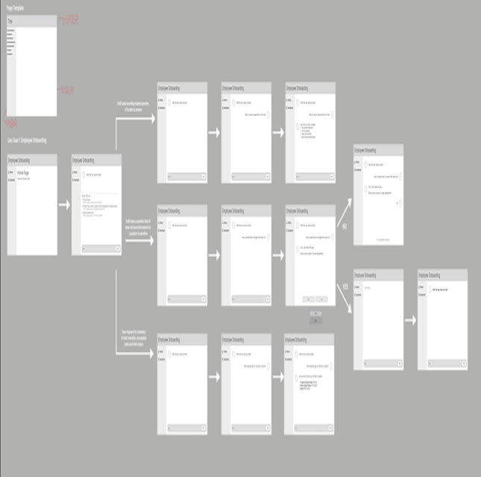
Actual Achievement PLAN & ACHIEVEMENT - EVIDENCE
Employee Onboarding confirmed as Core MVP - requirements, design, and technical approach finalized:
BA: Requirements are complete. Scope, escalation paths, assumptions, and AC are all captured.
UX: Updated design to include out-of-scope, escalation, success, and loadingstates.
Dev (Minh): AI Knowledge retrieval - technical solution outlined for ingestion, stack, and LLM connection
Dev (Nihal): Escalation and fallback - technical solution outlined for triggers and handoff path
Employee Onboarding - Low-Fidelity Design
29-Garage (RMIT) | AI Assistant for HR | Sprint 1 Playback

Slide 5
Why It Matters IMPACT & CANDOUR
The Onboarding Assistant targets a measurable HR cost
New hires currently wait on manual replies for repetitive, predictable questions
HR have to answer the same questions repeatedly, consuming their valuable time
By automating this HR can be employed on more valuable judgement tasks
Solution design and a proven technical solution exists supported by finalised requirements
29-Garage (RMIT) | AI Assistant for HR | Sprint 1 Playback

Slide 6
Blockers & Open Questions IMPACT & CANDOUR
Lack of Direction
Team had a lack of direction & idea in the initial sprint
No finalized business requirements, current sprint is focused on research
Finalization of business requirements planned to be completed in Sprint 2
29-Garage (RMIT) | AI Assistant for HR | Sprint 1 Playback

Slide 7
Task Allocation & Time Spent TRANSPARENCY & DIRECTION
Full Sprint 1 total (Weeks 1-3)
PM (Nawres)
Use case research + shortlist + task coordination + Playback deck + Sprint 2 plan
12 hrs
Dev 1 (Minh)
Onboarding tech research (Wk2) + AI knowledge retrieval technical approach (Wk3)
12 hrs
Dev 2 (Nihal)
Service request classification research (Wk2) + escalation/fallback technical approach (Wk3)
12 hrs
UX (Arman)
Prototype for both use cases (Wk2) + finalised Onboarding UX design (Wk3)
12 hrs
BA (Scarlett)
Requirements + validation (Wk2) + finalised Core MVP requirements (Wk3)
12 hrs
29-Garage (RMIT) | AI Assistant for HR | Sprint 1 Playback

Slide 8
Timeline & Next Steps TRANSPARENCY & DIRECTION
Team meeting: confirmed Employee Onboarding as Core MVP
Sprint 1 Week 3 planning session
Thursday: full team rehearsal
Today (Fri 11 Sept): Sprint 1 Playback
WHAT'S NEXT
TIMELINE
Sprint 2 begins by finalising detailed acceptance criteria (Week 1), then building the Employee Onboarding Assistant directly on our validated design and technical approach
29-Garage (RMIT) | AI Assistant for HR | Sprint 1 Playback

Slide 9
Scarlett Heng BA · TEAM CONTRIBUTION · 1 MINUTE
WHAT I CONTRIBUTED THIS SPRINT
Researched & defined requirements for the HR AI Assistant
Documented MVP scope, functional reequipments, AC, edge cases and human escalation
Refined requirement after Employe Onboarding was selected as the core use case
Validated the UX prototype against the requirements
ONE HONEST BLOCKER / LEARNING
Limited document about this topic or ideas what we need to do
Document need to clear and testable rather than guessing

Slide 10
Arman Gholami UX · TEAM CONTRIBUTION · 1 MINUTE
WHAT I CONTRIBUTED THIS SPRINT
Individual research on a use case for AI in HR (HR Policy Questions)
Low-Fidelity Prototypes based on the two shortlisted use cases
Demonstrated the user’s journey through the different scenarios.
Design/Styling yet to be finalized, but will be done by the end of the week.
ONE HONEST BLOCKER / LEARNING
Unwell during week 2, poor time management.
Underestimated how much it pushed my work back (breaks, rest)
Work was overdue
More time allocation needed

Slide 11
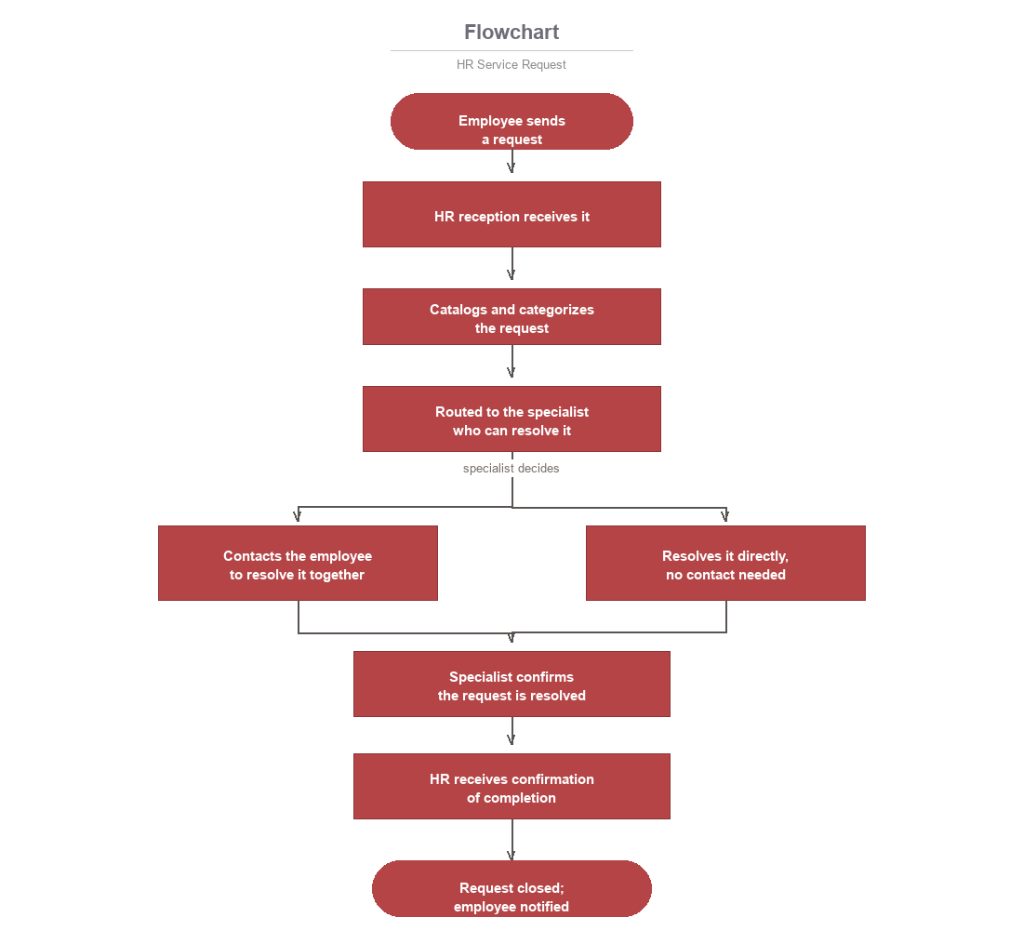
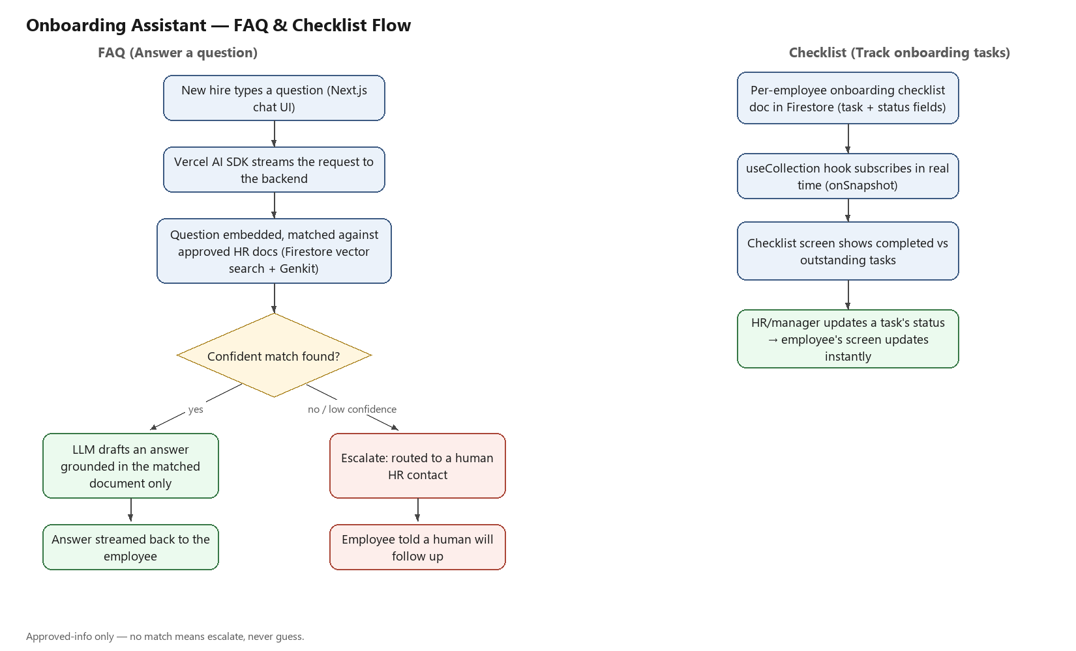
Minh Quang Tran Dev · TEAM CONTRIBUTION · 1 MINUTE
WHAT I CONTRIBUTED THIS SPRINT
Researched HR Service Requests in Week 1, recommended the Onboarding technical stack in Week 2, and this week ran hands-on checks confirming the retrieval and LLM connection actually work, not just planned on paper.
Week 1 evidence — HR Service Request flow
ONE HONEST BLOCKER / LEARNING
Overthought the task requirements
found it hard to document my findings clearly
When that happened, I'd check a teammate's work or ask the PM directly rather than stay stuck guessing alone.
Week 2 evidence — Onboarding FAQ / checklist flow

Slide 12
Nihal Reddy Gaddam Dev · TEAM CONTRIBUTION · 1 MINUTE
WHAT I CONTRIBUTED THIS SPRINT
Week 1: Researched AI Interview Note-Taking and mapped the current vs AI-assisted process.
Week 2: Researched HR Service Request classification and routing approaches.
This week: Working on Employee Onboarding escalation and fallback behaviour
Coordinating the technical flow with Arman’s UX states
ONE HONEST BLOCKER / LEARNING
Too many possible tools and technical approaches at first
Narrowed the options based on what was realistic for the MVP
Learned to base technical decisions on project needs, not just tool features

